Slide 1
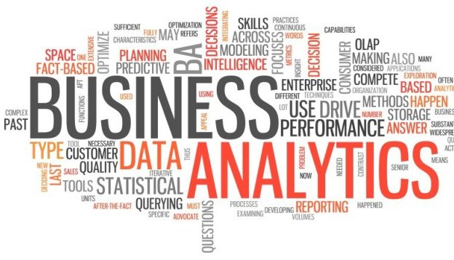
Analytics as a Service

Slide 2
Objective
Subscription based analytics and business intelligence platform providing standard industrial analytics or customer specific analytics.
Supporting any volume of data defined by subscription (Small/Big)

Slide 3
Objective
>85% Accuracy (Predictive)
Analytics
Prebuilt Analytic module
Customer Specific Analytics
Domain Centric
Platform
Multi tenant
Subscription based
Low cost solution
Dashboard + Bench marking, Self Reporting (Prerequisite for Analytics)
Business
Intelligence
Process Sharing - Domain agnostic

Slide 4
Service Offerings
Packaged BI
Causal Analytics
Advanced forecasting
Predictive modeling
Information Mgmt.
Big data Strategy and Solution
Business Intelligence
Packaged BI
Advanced Analytics
Advanced forecasting
Data Governance
Master Data Management
Country Based Compliance and regulation (Begin with India)
Causal Analytics
Mobile BI
Predictive modeling
What happened?
Why did it happen?
What will happen?
What should I do?

Slide 5
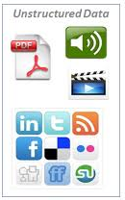
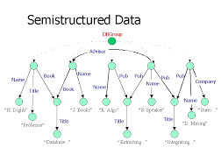
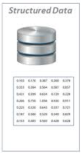
Data Roadmap
Structured Data Source
Semi-structured
Un-structured
Platform evolves

Slide 6
Technology Selection
Criteria
Benefits
Enterprise hardened Open Source Applications/Software with active community
Highly Scalable with minimal effort
Built on familiar technologies (Java, SQL and etc..)
Adherence to standards
Compatibility with other applications
Easy for deployment and monitoring
Extensible Architecture
Lower TCO
Stable platform
Minimum learning curve
Lower development and maintenance cost
Easy to troubleshoot

Slide 7
Platform Design Approach
Meta data driven
Reusable components
Configuration Based ETL
Template Based BI Objects

Slide 8
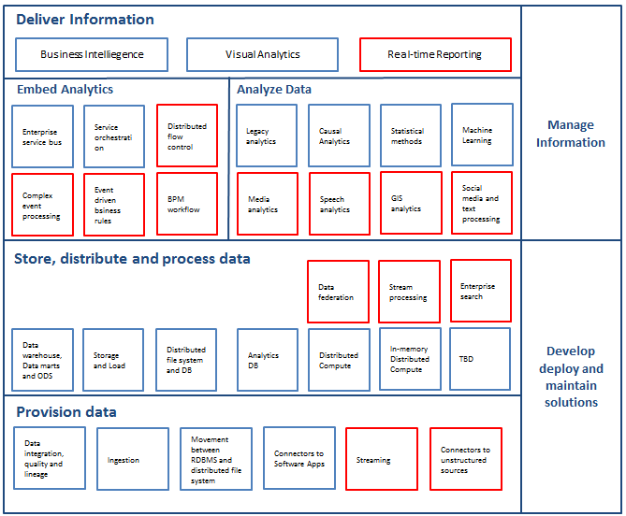
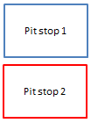
Proposed Architecture

Slide 9
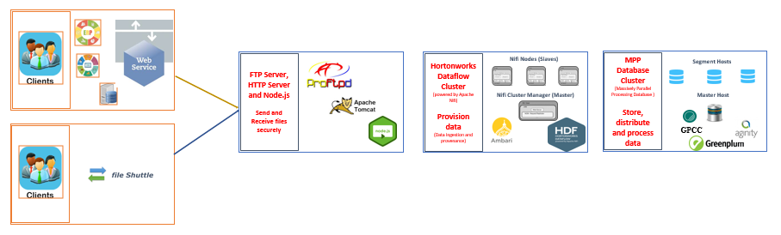
Platform

Slide 10
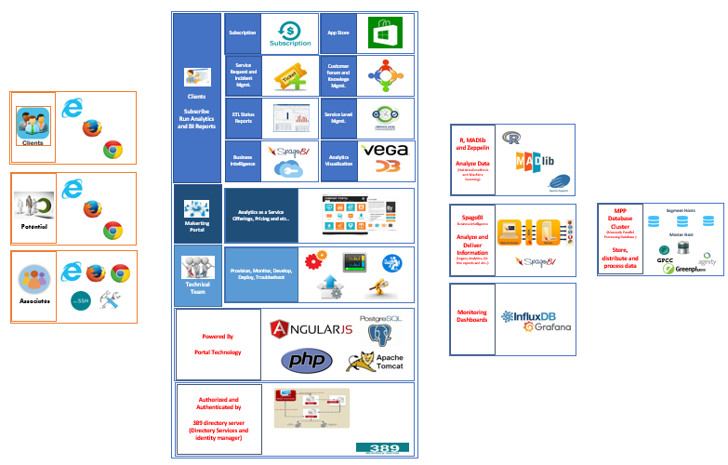
Platform Contd..

Slide 11
Why Horton Works Dataflow for ETL?

Slide 12
Why Greenplum for Database?

Slide 13
Why SpagoBI for Business Intelligence

Slide 14
Why MADlib and R for Analytics?

Slide 15
Why Vega for Visualization?

Slide 16
<>

Slide 17
<>

Slide 18
<>

Slide 19
<>

